Slide 1


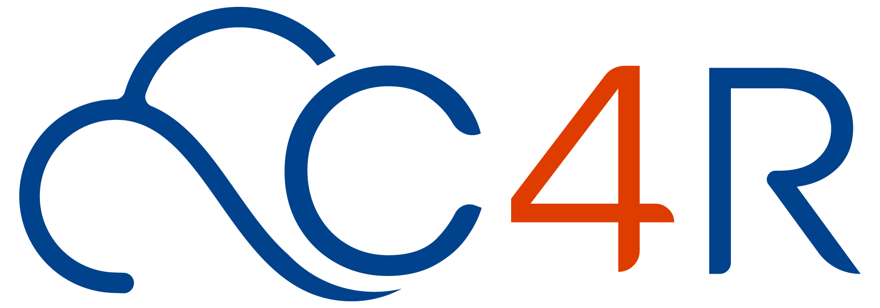

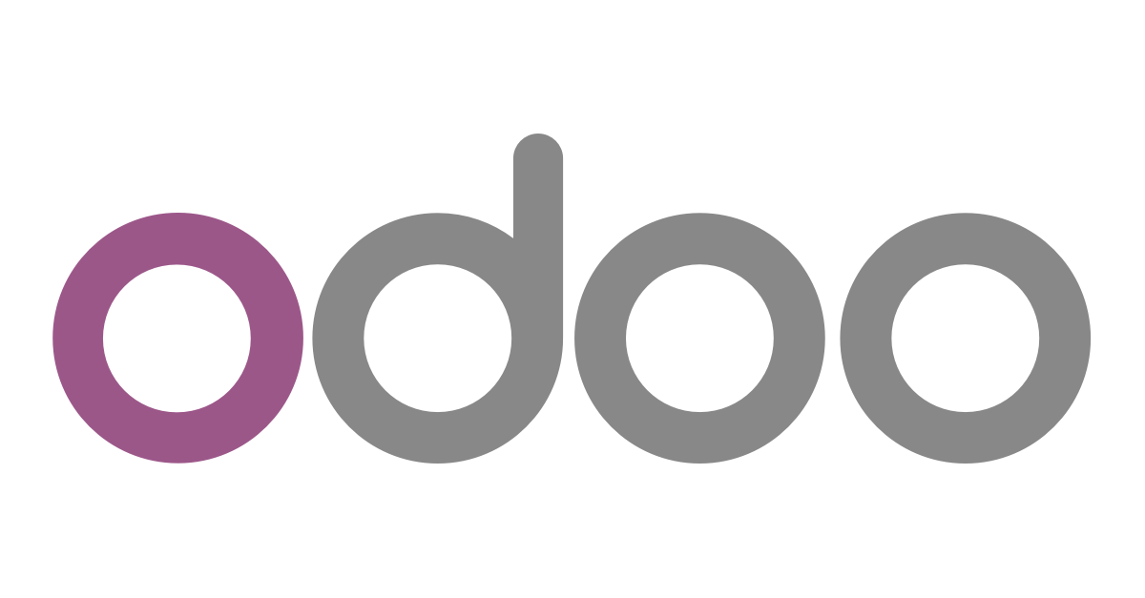
SaaS
PaaS
Profile
IaaS
SaaS
365
PaaS
CMS
ERP+
IaaS
LMS
CRM

Slide 2
About Us
Cloud4Rain (C4R) is an emerging IT service Provider focused on Managed Services, Infrastructure, Business Continuity, Risk Management, Security, Datacenters, Mobile Solutions, and Digital Transformations solutions provider.
C4R provides end-to-end digital and cloud solutions across all industries in the MEA region.
C4R focuses on translating partners’ needs into an innovative advanced solution that helps them embrace digital transformation, improve their time to market, and enhance the ROI.
C4R delivers system integration, implementation, consulting, and support services to an extensive and diversified blue-chip clientele comprising large government and private sector firms across multiple industries with leadership in serving Tier 1 clients in the Banking, Telecom, Oil & Gas, Government, defense, Real Estate, Retail, and SME sectors.
C4R Employs professionals and consultants who are highly experienced, certified, skilled, and carry a huge volume of technical experience. They were engaged in many named mega projects in the region and are always connected to cutting-edge technologies.

Slide 3






Our Services
Cloud Solutions
Managed Services
Consultancy
Application &Software Development
Digital Transformation
Infrastructure

Slide 4
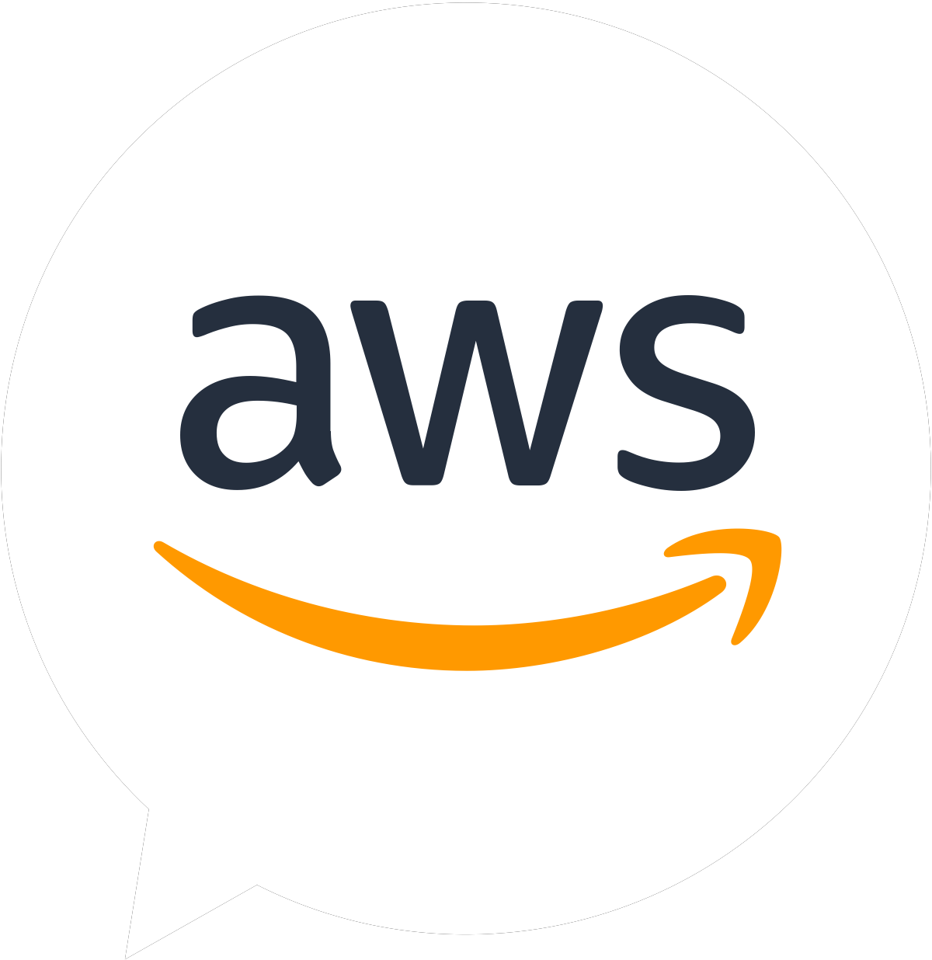
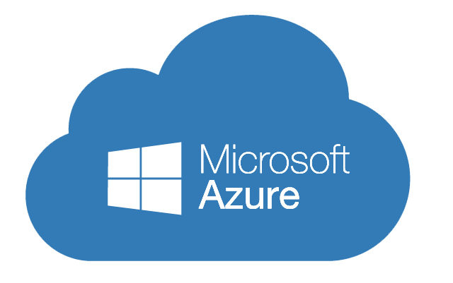
Cloud4Rain Services
Hybrid Cloud
At Cloud4Rain, our team of C4R experts is dedicated to helping you select the optimal hybrid cloud solution for your business. We understand the importance of incorporating scalable infrastructure, seamless data access, and robust privacy measures tailored to your specific requirements. With our expertise, we ensure that your hybrid cloud environment delivers the perfect balance of performance and agility.
Public Cloud
As a trusted partner, Cloud4Rain collaborates with renowned third-party cloud providers such as Microsoft Azure and AWS. Our strategic partnerships enable us to offer flexible, versatile, and revenue-generating public cloud solutions. By leveraging the industry-leading capabilities of these platforms, we empower your business to unlock new opportunities, enhance operational efficiency, and drive sustainable growth.
Private Cloud Services
At Cloud4Rain, we provide diverse private cloud solutions that align with industry best practices and standards. Our team is committed to delivering secure, reliable, and highly customizable private cloud environments. By leveraging cutting-edge technologies and adhering to strict security protocols, we ensure that your data remains protected while you enjoy the benefits of private cloud infrastructure tailored to your unique business needs.
Tailored Solutions:
Understanding that each business has distinct requirements, our team recommends cloud adoption models that best align with your specific needs. We take into account factors such as security, scalability, and performance expectations to design customized cloud solutions. With our expertise, you can confidently embrace the cloud, leveraging its potential to drive innovation, streamline operations, and achieve your strategic goals.
As Cloud4Rain, we are committed to delivering exceptional cloud services that empower your business to thrive in the digital landscape. Our team of experts is poised to guide you through every step of your cloud journey, ensuring seamless integration, robust security, and tangible business outcomes.

Slide 5

Application and Software Development
At C4R, we offer software development solutions that are built upon the pillars of reliability, efficiency, portability, and maintainability. Our expertise spans every stage of the development process, ensuring that our solutions deliver exceptional performance and seamless functionality across various digital mediums.
Innovative and High-Performance Digital Portals:
We specialize in developing innovative and high-performance Digital portals tailored to meet the unique business requirements and objectives of our clients. Whether it's an enterprise portal, customer portal, or any other type of portal, our team is dedicated to delivering cutting-edge solutions that empower businesses to enhance collaboration, streamline processes, and elevate customer experiences.
Customized Solutions:
C4R boasts a team of professional experts proficient in a wide range of Customized Solutions. We have the expertise to develop robust and scalable solutions that empower businesses to thrive in the digital era. From creating captivating online storefronts to implementing secure payment gateways and personalized customer experiences, we leverage the latest technologies to drive growth and success for our clients.
Automation and Information Sharing:
Our custom web portals are meticulously crafted to automate processes and facilitate efficient information sharing at multiple levels. By harnessing the power of web and application services, we enable organizations to optimize workflows, improve productivity, and foster seamless collaboration between teams, both on-site and remotely.

Slide 6
Cloud4Rain Applications
  Enterprise Resources Planning ERP+ - C4R is a robust, open-source ERP+ system built on the Odoo community version. It is specifically tailored to cater to the unique requirements of small and medium-sized businesses (SMBs). With its customizable features, this ERP+ solution seamlessly integrates various business processes, including finance, human resources, inventory management, and more.
Asset Management System (AMS): C4R Asset Management system is designed to empower businesses with efficient tracking and management of their assets. This comprehensive solution enables organizations to effectively monitor and optimize their asset utilization, leading to improved productivity and cost savings. this system offers a solid return on investment and provides businesses with the tools they need to streamline their asset management processes.
Learning Management System LMS C4R is a comprehensive software solution designed to facilitate, streamline, and enhance the administration, documentation, tracking, reporting, automation, and delivery of digital educational courses, training programs, and learning and development initiatives.
With C4R LMS, educators, trainers, and organizations gain access to a powerful platform that empowers them to create engaging and interactive learning experiences. Our LMS offers a user-friendly interface and robust features that enable seamless course management, learner engagement, and performance tracking.
Digital Content Management for Courts (DCMC): Developed and deployed in Egypt's Court of Cassation by the C4R team, this Digital Portal revolutionizes the management of justice courts. It features a comprehensive digital library, an efficient archiving system for all rulings documents, streamlined conference management, and the capability to issue and manage digital magazines. This state-of-the-art solution brings unprecedented efficiency and organization to court operations.

Slide 7

Cloud4Rain Applications
  Technologies We Utilize:
  Our team is well-versed in utilizing cutting-edge technologies to develop exceptional e-commerce solutions. We leverage industry-leading technologies such as (Microsoft, Odoo, Opensource and Oracle) to create secure, scalable, and feature-rich platforms that cater to the unique needs of each business.
  At C4R, we are committed to delivering software development solutions that exceed expectations. Our team of professionals combines technical expertise, industry knowledge, and a customer-centric approach to develop solutions that drive business growth and success.
  Partner with C4R to unlock the full potential of your digital initiatives and take your business to new heights. Contact us today to learn more about our software development solutions and how we can help you achieve your goals.

Slide 8
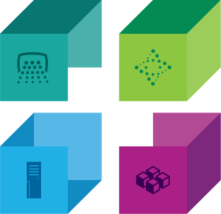
Cloud4Rain Managed Services
Four major categories of Managed Services have emerged that transform how IT services can be consumed
Managed Software
Managed Business Process
Collaboration
Analytics
ERP / SCM / CRM
Core Banking
Industry applications
Industry-specific processes
Employee benefits management
Business travel
Procurement
Managed Infrastructure
Managed Platform
Servers
Storage
Network
OS, Virtualization
Dynamic provisioning
Security
Middleware
Database
Development tools
Web Application
Backup / Restore
Security
With Managed Services, IT resource consumers can apply all these services.

Slide 9

C4R Managed Services Models
Clients cost benefits increase as you move to the right…
Traditional IT Service
Managed Infrastructure
Managed Platform
Managed Software
Applications
Applications
Applications
Applications
Data
Data
Data
Data
Runtime
Runtime
Runtime
Runtime
Middleware
Middleware
Middleware
Middleware
O/S
O/S
O/S
O/S
Virtualization
Virtualization
Virtualization
Virtualization
Servers
Servers
Servers
Servers
Storage
Storage
Storage
Storage
Networking
Networking
Networking
Networking
Client Manages
C4R Manages services
Standardization; OPEX savings; faster time to value
Client Manages
C4R Manages services
Standardization; OPEX savings; faster time to value

Slide 10
Managed Services Value
This is the space we prefer to play, where we can differentiate ourselves through value and best practice
“Run my Process”
Another way to look at C4R and MS.
from a value perspective.
“ Take IT
off my hands”
Business Process
Higher Value
” Manage my
Apps”
All IT
All Business Process IT
Out tasking
Staff Augmentation
“ Manage my
Servers”
Applications
Applications
Applications
“ Host my
Servers”
Infrastructure
Shared Infrastructure
Custom Infrastructure
Shared Infrastructure
“ Monitor my servers in my DC”
Data
Center / Remote
Data
Center / Remote
Data
Center / Remote
Data
Center
Data
Center
“ Help me with some tasks”
BASE
BASE
BASE
BASE
BASE
BASE
Do it yourself We help you do it We do it for you
Consultancy (Business , IT, BCM, …etc)

Slide 11

Consultancy Services
At C4R, we have a team of highly skilled and talented professionals who are experts in providing consulting services across a wide range of industries. We specialize in helping organizations assess and manage risk, ensure business continuity, and improve their IT strategy and services.
Our consulting services cover a range of specialties, including risk management, business continuity, IT strategy, IT services, maturity assessment, COBIT, IT infrastructure, security, data centers, ITIL best practices, and ISO 22301.
Whether you need assistance with developing a comprehensive risk management plan, ensuring business continuity in the face of unexpected disruptions, or optimizing your IT infrastructure, we have the expertise to help you achieve your goals.
Our team works closely with clients to understand their unique needs and objectives, and we develop customized solutions tailored to their specific requirements.
We take pride in providing high-quality consulting services that deliver measurable results and drive long-term value for our clients.
At C4R, we are committed to staying at the forefront of industry best practices and emerging technologies. We continuously invest in our team's professional development to ensure that we are equipped with the latest knowledge and skills to help our clients succeed.
Contact us today to learn more about our consulting services and how we can help your organization achieve its goals.

Slide 12

Digital Transformations
At C4R, we understand the critical importance of digital transformation in today's rapidly evolving business landscape. With a comprehensive suite of services, we are dedicated to supporting and accelerating your organization's journey towards unlocking productivity gains across all levels of your operations. From developing a digital business strategy aligned with your key objectives to deploying and fine-tuning digital solutions, we provide end-to-end support to drive your digital transformation initiatives.
Digital Transformation Services:
Digital Transformation Consulting:
Our experienced consultants work closely with your organization to develop a robust digital transformation strategy tailored to your unique needs. We conduct in-depth assessments, identify opportunities for improvement, and define a roadmap that aligns technology investments with your business objectives. Our consulting services ensure that your digital initiatives are well-planned, cost-effective, and deliver tangible outcomes.
Transition Services:
We understand that transitioning to a digital environment can be complex. Our transition services facilitate a smooth and seamless migration from legacy systems to modern digital platforms. We assist in infrastructure modernization, application transformation, data migration, and change management, ensuring minimal disruption to your operations. Our expertise in managing transitions enables your organization to embrace digital capabilities efficiently.
Operation Services:
To ensure the successful operation of your digital solutions, we offer comprehensive operation services. Our team provides ongoing support, maintenance, and continuous improvement for your digital infrastructure and applications. We monitor performance, resolve issues, and implement enhancements to optimize your digital environment. With our operation services, you can focus on core business activities while we manage the technical aspects of your digital transformation.

Slide 13
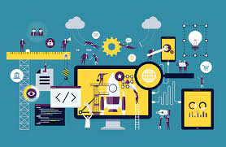
Digital Transformations
Our Approach and Benefits:
At C4R, we take a collaborative approach to digital transformation, working closely with your organization to understand your unique challenges and opportunities. By leveraging our expertise and industry knowledge, we help you identify high-value pilot projects and innovation initiatives that lay the foundation for scalable digital solutions. Our comprehensive suite of services ensures a holistic approach to your digital transformation journey, enabling you to unlock productivity gains and drive sustainable growth.
By partnering with C4R for your digital transformation needs, you can expect:
- Expert guidance in developing a digital business strategy aligned with your objectives.
- Seamless transition from legacy systems to modern digital platforms.
- Ongoing support and maintenance to optimize your digital infrastructure.
- Access to a wide range of digital talents and resources.
- Enhanced operational efficiency and agility through technology-driven solutions.
- Improved customer experiences and engagement through digital innovations.
Empower your organization to thrive in the digital era with Cloud4Rain's digital transformation services. Contact us today to embark on a transformative journey and unlock the full potential of your business.

Slide 14
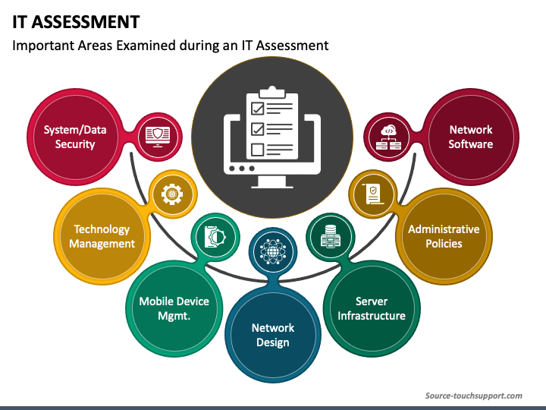
IT Assessment
At C4R, We possess comprehensive capabilities in conducting full IT assessments across all layers of your organization's IT infrastructure. Our expert team specializes in evaluating your IT environment from end to end, identifying strengths, weaknesses, and opportunities for improvement. With our in-depth knowledge and experience, we deliver an in-depth analysis that enables you to make informed decisions and optimize your IT investments.
Key Capabilities:
Infrastructure Assessment:
Our team conducts a thorough evaluation of your IT infrastructure, including network architecture, hardware, servers, storage, and virtualization. We assess the performance, reliability, and scalability of your infrastructure, identifying any bottlenecks or areas requiring enhancements. By examining your infrastructure layer, we ensure a solid foundation for your IT operations.
Security Assessment:
Security is a critical aspect of any IT environment. We perform a comprehensive review of your security measures, including firewalls, intrusion detection systems, access controls, and data protection mechanisms. Our assessment identifies vulnerabilities, potential risks, and compliance gaps, enabling us to provide recommendations for strengthening your security posture.
Application Assessment:
Applications are the backbone of your business processes. We evaluate your application landscape, including enterprise software, custom applications, and third-party solutions. Our assessment focuses on performance, functionality, integration, and alignment with your business objectives. We provide insights to optimize application usage, identify opportunities for consolidation, and ensure seamless operation.

Slide 15
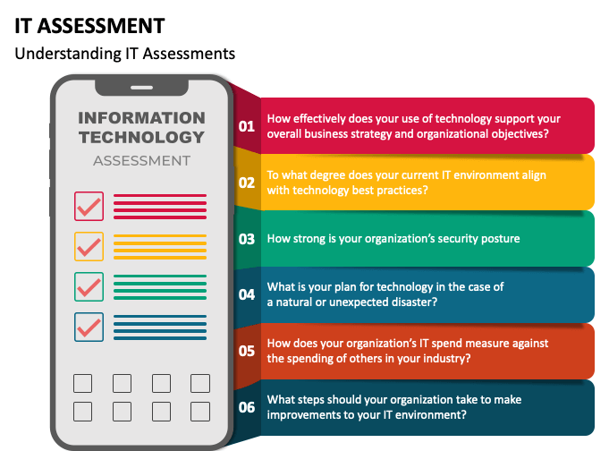
IT Assessment
Data Assessment:
Your data is a valuable asset that requires proper management and protection. We analyze your data storage, backup, and recovery strategies, ensuring data integrity, availability, and compliance with data privacy regulations. Our assessment helps you optimize data storage and backup processes, implement efficient data lifecycle management, and improve disaster recovery capabilities.
IT Governance and Processes Assessment:
Effective IT governance and streamlined processes are essential for operational efficiency. We evaluate your IT governance framework, IT policies, and procedures, assessing alignment with industry best practices and compliance requirements. Our assessment identifies areas for process improvement, enhances IT service management, and optimizes resource allocation.
Cloud Readiness Assessment:
As cloud adoption becomes increasingly important, we assess your organization's readiness for cloud services. We evaluate your existing infrastructure, applications, and data to determine the suitability for cloud migration. Our assessment provides insights into cost savings, scalability benefits, and security considerations, assisting you in developing a cloud adoption strategy.
By leveraging our expertise in conducting full IT assessments, we provide you with a holistic view of your IT landscape. Our detailed reports and recommendations empower you to make informed decisions, prioritize investments, and align your IT strategy with your business goals. Trust Cloud4Rain to deliver a comprehensive assessment that maximizes the value of your IT infrastructure.

Slide 16

Integrated Infrastructure Services
C4R is a leading provider of Implementation and Integration IT services, serving clients across various industries and geographies. Our team of experienced professionals offers end-to-end solutions that help businesses streamline their operations, reduce costs, and improve efficiency.
We specialize in implementing and integrating complex IT systems, such as ERP+, CRM, LMS, and CMS, to help organizations seamlessly manage their processes and data. Our team has extensive experience in designing, developing, and deploying customized solutions tailored to meet the unique needs of each client.
At C4R, we pride ourselves on our commitment to quality and customer satisfaction. We work closely with our clients to ensure that each project is completed on time, within budget, and to their specifications.
Our team of experts is available around the clock to provide ongoing support and maintenance to ensure our clients' systems operate at peak performance.
Our services include:
IT system implementation | IT system integration
Custom software development | Data migration and conversion
Testing and quality assurance | Maintenance and support

Slide 17












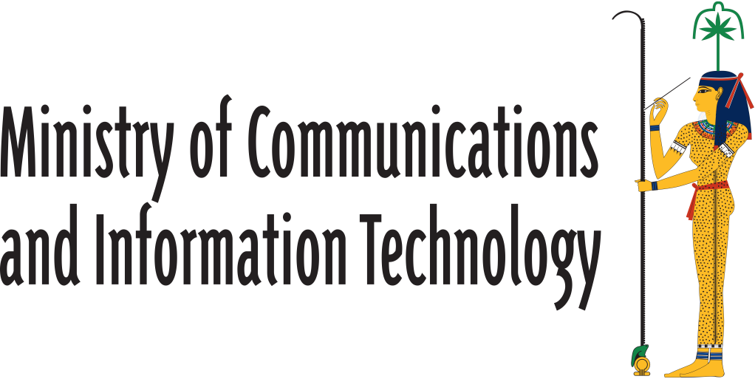










C4R Success Stories
Selected
Clients

Slide 18

Questions & Answers

